Slide 1
Presentation title 30 point
Second line if required
Presentation sub-title 24 point
Second line if required

Slide 2


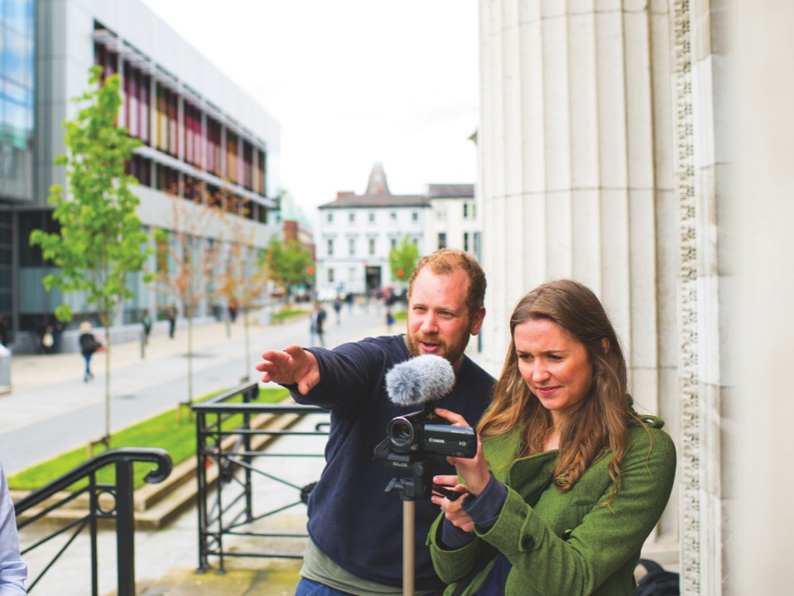
Images should
Be uniform in size
Compliment the content
Not impact on the copy area

